Slide 1
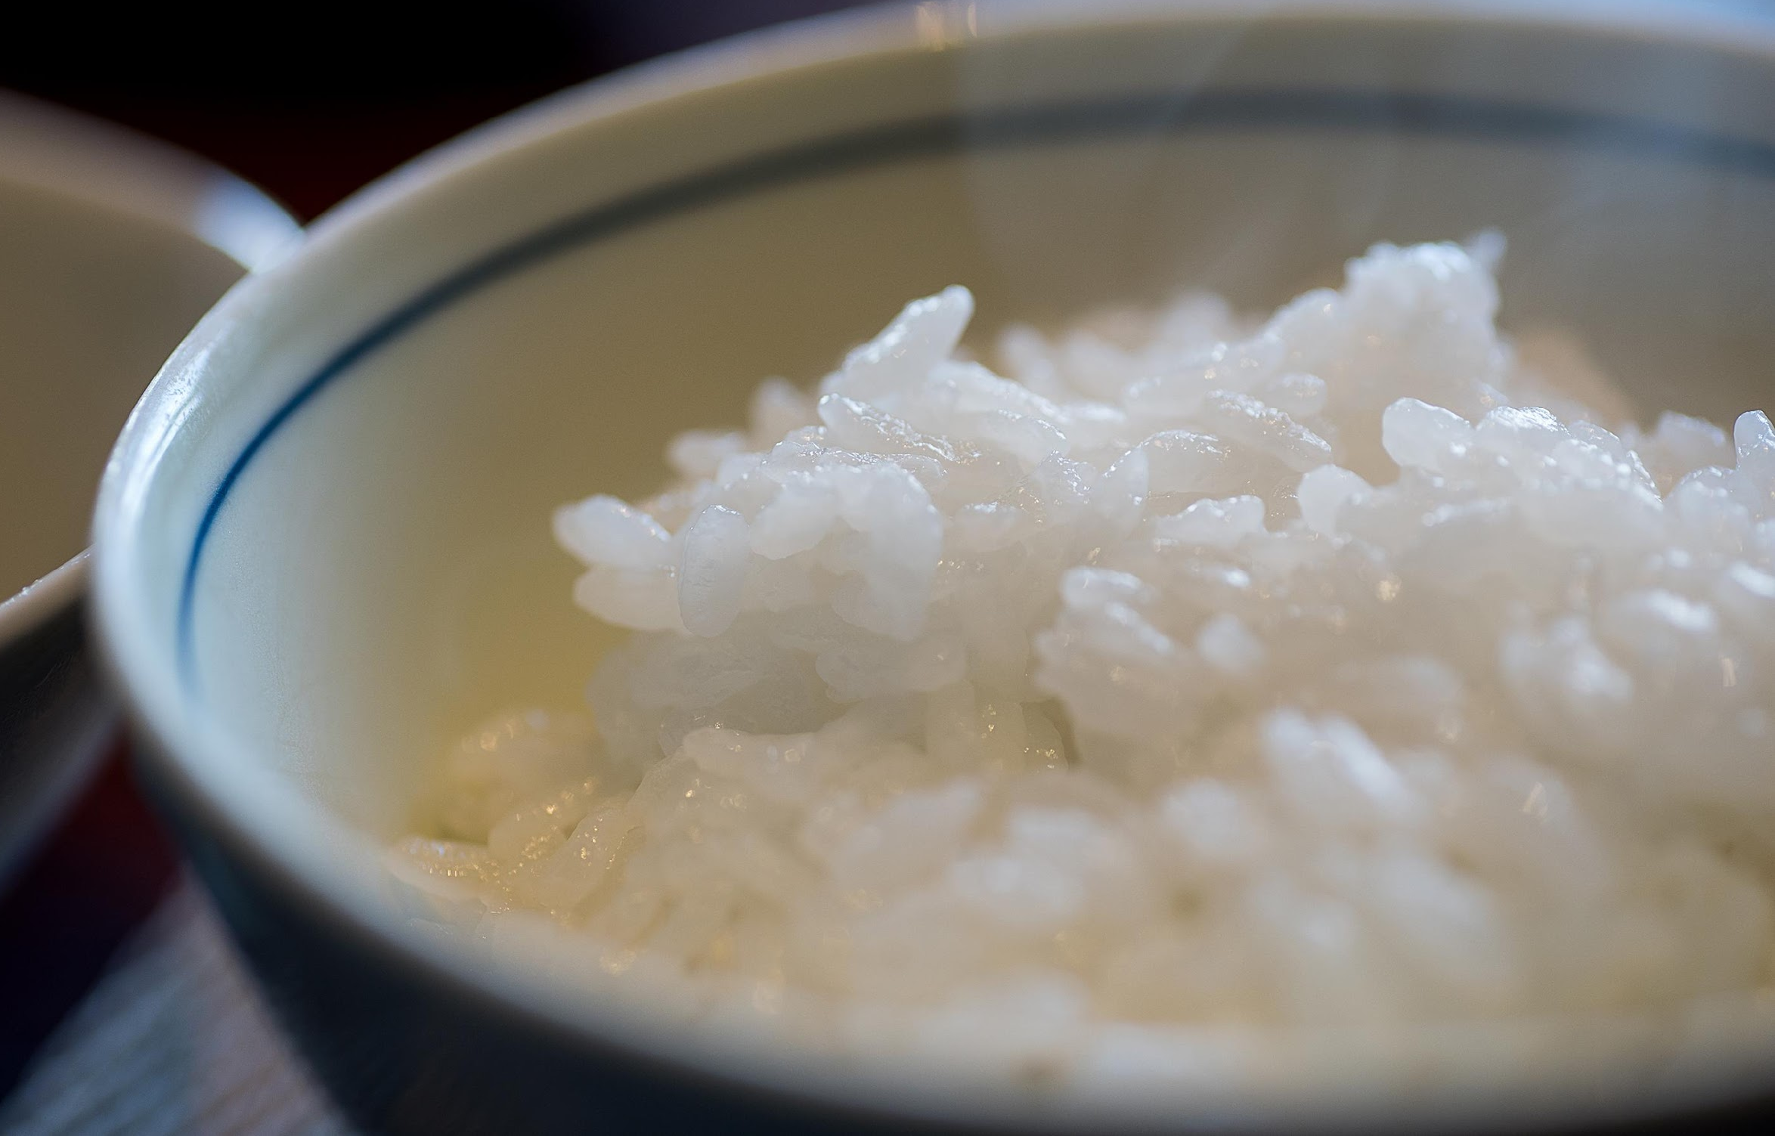
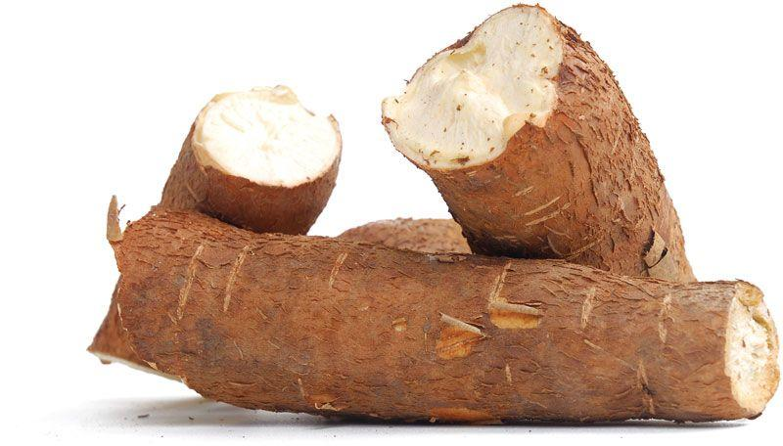
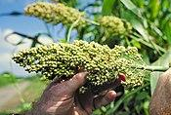
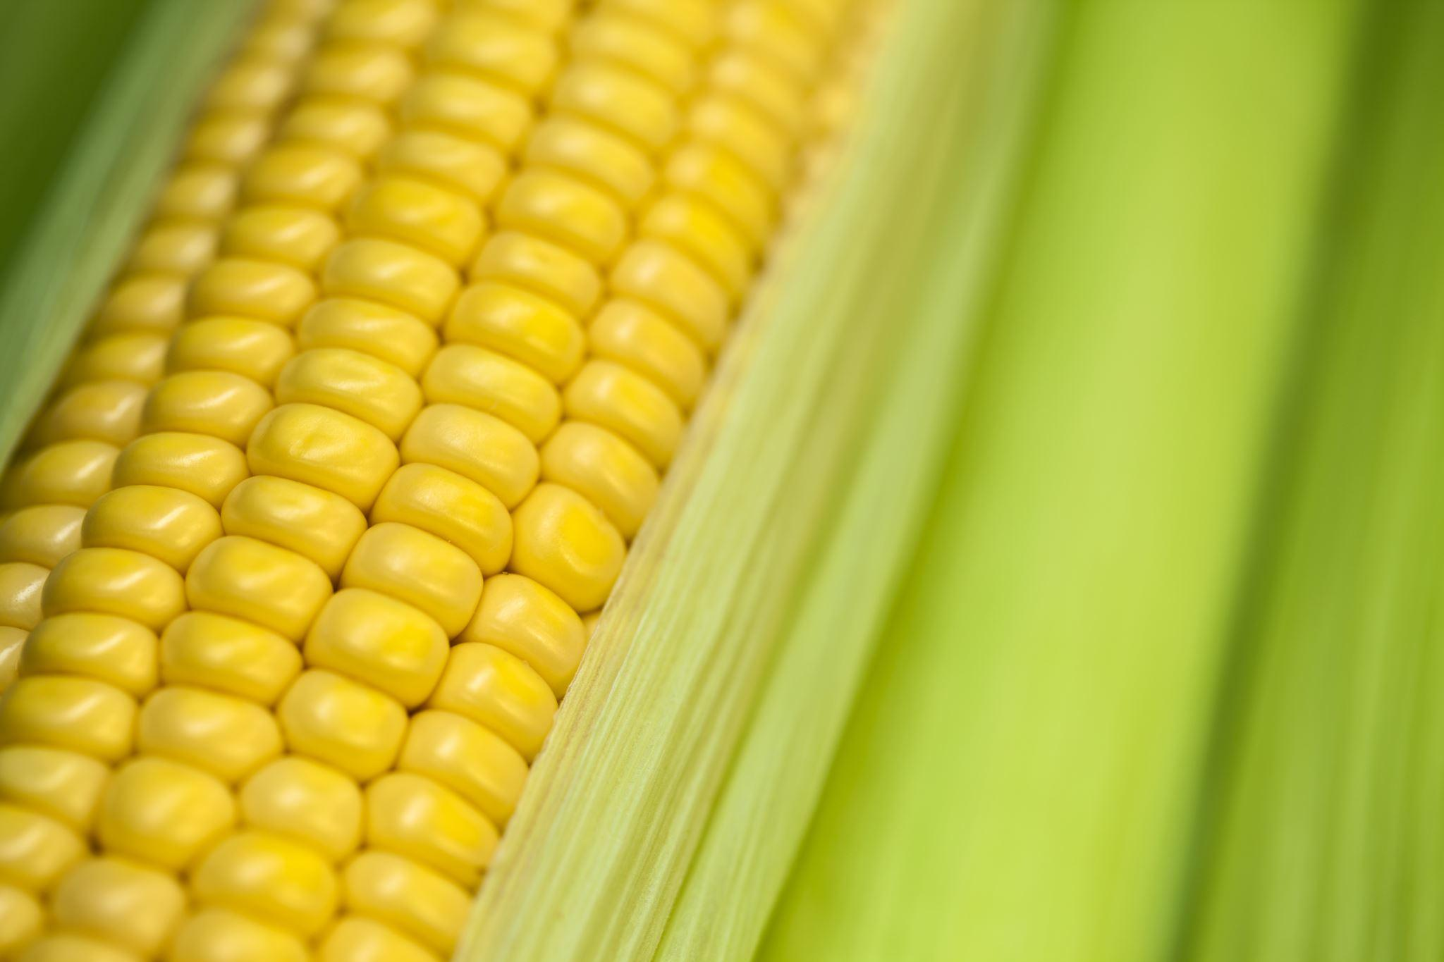
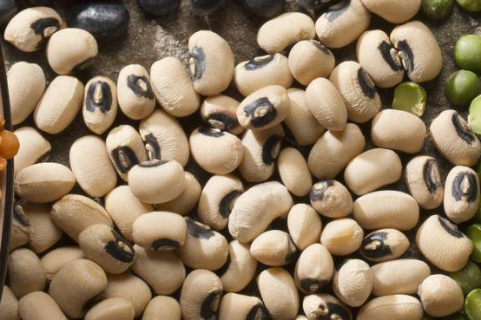

Mining useful alleles for climate change adaptation
Ayelet Salman-Minkov
Jeff Ross-Ibarra and Dan Runcie’s labs
UC Davis
10.12.2022

Slide 2
Introduction
The goal:
To find out what would be the most effective way to use GEA in developing breeding lines?
We would like to take into consideration:
Genetic architecture of the trait
Breeding strategies

Slide 3
Future environmental optimum
elite line
FITNESS
landraces
too cold
optimum
too hot
Future optimum

Slide 4
Genetic architecture of the trait
Different breeding strategies success is expected to depend on the genetic architecture.
If we look at a space of allele frequencies and their effect on the trait:
1
2
1 - large effect alleles are rare, small effect allele are common
2 - large effect, common alleles
3 - small effect, rare alleles
Allele
Frequency
3
Effect on trait
Which breeding strategies are most likely to work under a certain genetic architecture?
We will combine simulations of the above genetic architecture scenarios together with different breeding strategies, to find out what would work better.

Slide 5
The approaches that will be tested:
Genotype and environmental association (GEA) & Marker Selection
Use GEA to select candidate markers and introgress these into elite lines
Prediction & QTL mapping
Use Genomic Prediction to select candidate lines that may have good QTL
Make landrace x elite mapping populations and identify QTL to introgress into elites
Prediction & Recurrent Selection
Use Genomic Prediction to select candidate lines
Make crosses among the lines and elites to create a synthetic population
Advance this synthetic population with Recurrent Selection in target environment

Slide 6

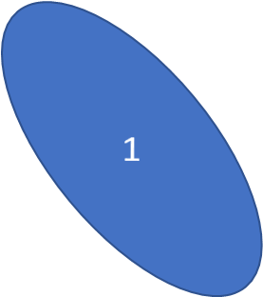

Genetic architecture of the trait
Expected performance of each approach:
2
2
GEA
Will work best when the effect is high and the alleles are common
Allele
Frequency
3
Prediction + QTL mapping will work when the effect is high
high effect
Effect on trait
Prediction + genetic selection
will work when the effect is not too small

Slide 7
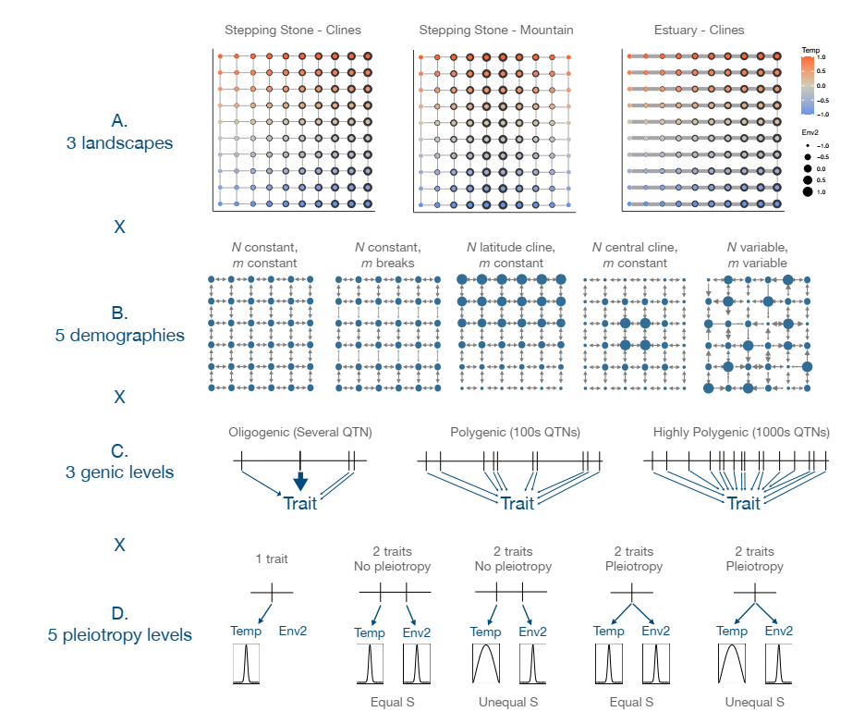
Data:
Simulated demography and environmental data to identify factors for predicting which breeding strategy is most likely to work for a specific crop
Temperature
2 landscapes
Drought
Adapted from Lotterhos 2022

Slide 8
GEA and Marker Selection
1. GEA methods like LFMM / linear model / mixed models will be used for selecting 50 best markers
2. Each L1 line will be crossed to the breeding line B1
3. Phenotype + Genotype
4. Significance test to test if the marker is useful
5. Introgress useful markers into B1 by backcrossing
Breeding simulations:
L1
(Selected by GEA marker)
X
Inbred B1
F1
Advantages:
Genotype only at the target marker
Problems:
Might not catch rare alleles;
Could be that an advantage in heat environment
does not lead to advantage in yield (in a different genetic background)
X
F2
Phenotype (yield) + Genotype; Significance test

Slide 9
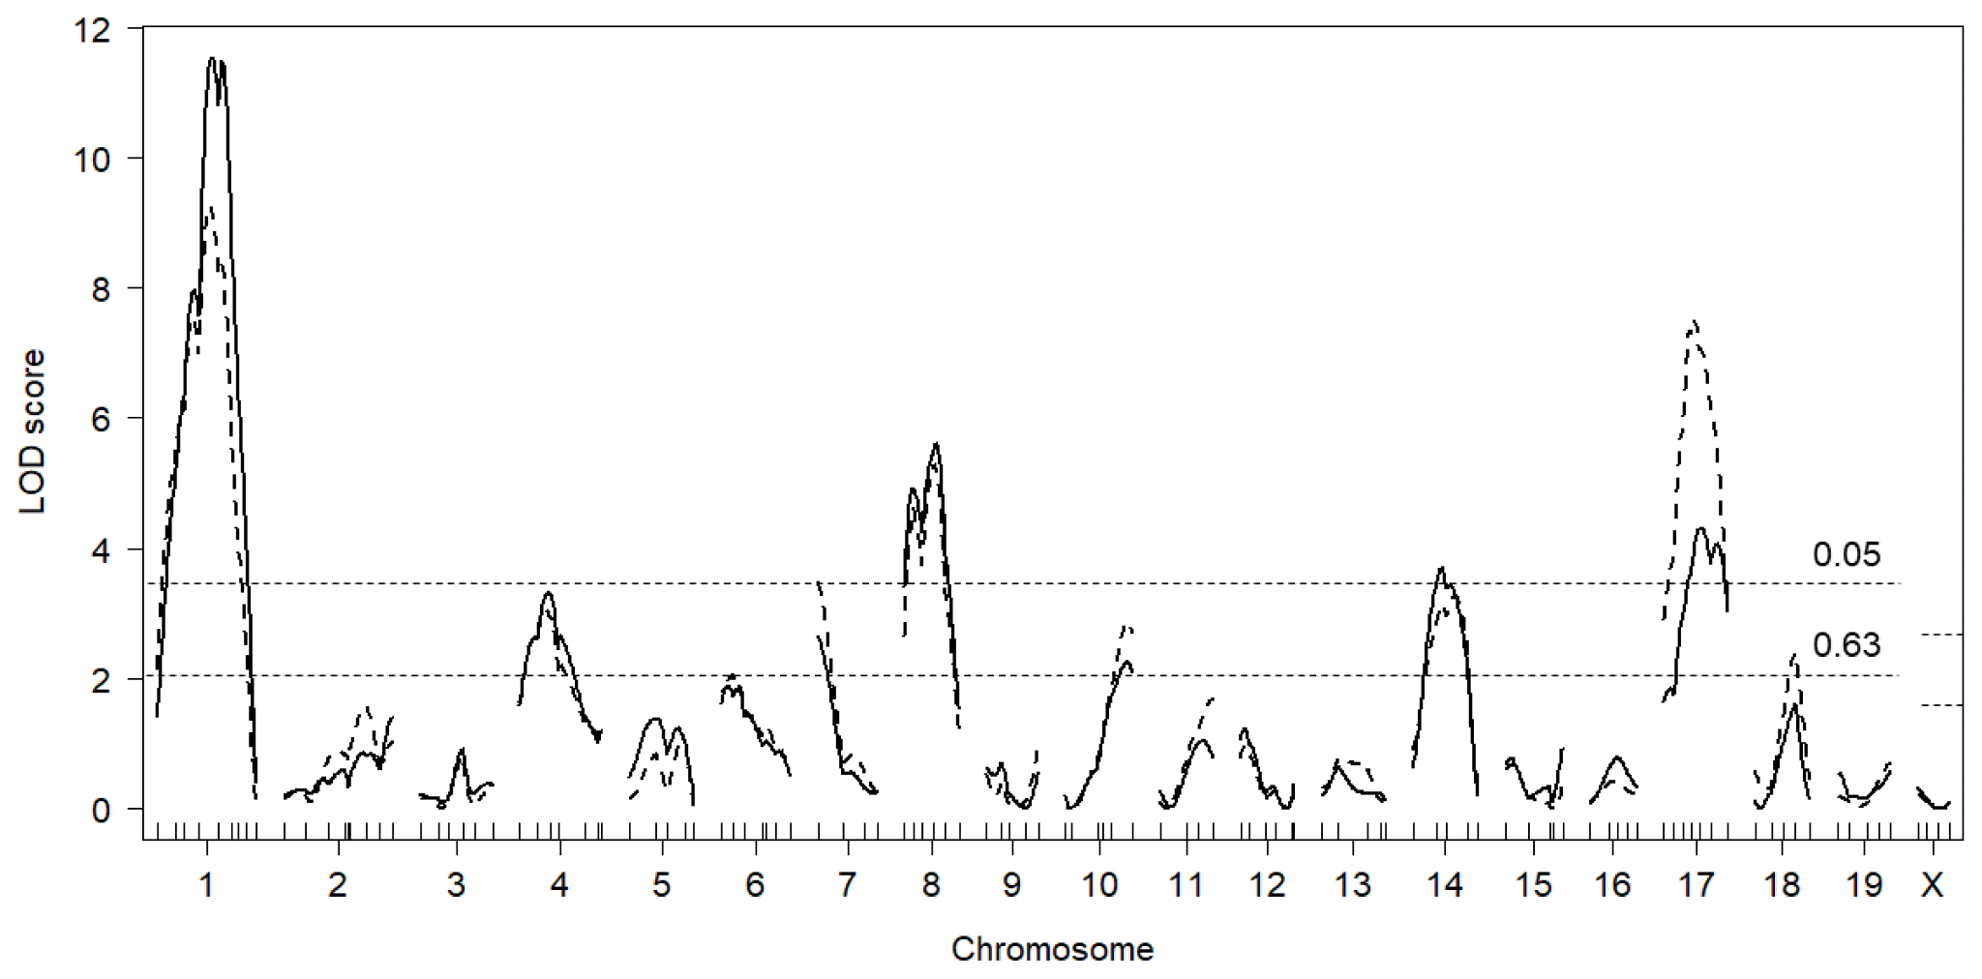
Prediction and F2 QTL mapping
1. Prediction methods will be used for selecting lines L1
2. QTL mapping will be done to F2 individuals to identify potential markers
3. Introgress beneficial QTL into B1 by backcrossing, genotyping at markers for each QTL
L1
(Selected by
Prediction)
Breeding simulations:
X
B1
F1
X
QTL map plot for example:
F2 segregating population
F2
F2
F2
F2
F2
Phenotype and QTL mapping
Advantages:
Here we test in ‘real’ environment;
Rare, large effect alleles can cause a line to be high ranked
No need to identify the beneficial alleles at the beginning

Slide 10
Prediction & Recurrent Selection
1. Prediction methods will be used for rating lines
2. Highly rated lines L1 will be crossed to breeding line B1; Recurrent selection, based on phenotype.
Breeding simulations:
L1
(Selected by
Prediction)
X
B1
F1
X
B1
Recurrent selection based on phenotype (yield)
and backcrossing
Advantages:
No need to identify the beneficial alleles at the beginning;
We could catch polygenic adaptation since we do not choose based on a single allele;
Lines can be selected based on rare alleles, but progress is possible even if all alleles have small effect;
We test in ‘real’ environment

Slide 11
Questions to the breeding specialists:
Are there other breeding approaches for incorporating beneficial landrace alleles that you are applying, and we should add to the evaluation?
Are there other simulations to consider? Demography / maps ?
How should we evaluate cost?
How many individuals will be grown?
How much genotyping (#loci * #individuals) and phenotyping will be done?

Slide 12
Phenotype 500 individuals
Genotype ~1000 snps (20 from each 50 BC lines)
Approaches Efforts Estimation
50 accessions
(Selected by 50 markers found in GEA)
Homozygous to the marker
1. GEA
50 Backcrossed lines
Phenotype 10 individuals from each line
Significance test:
5 ind. with new allele
vs.
5 ind. with reference allele
Phenotype 500 ind.
Genotype ~25000 snps
2. Prediction
5 individuals selected by prediction
5 F2 pops.
Take 100 from each
QTL analysis for the trait; Do we find advantageous QTLs?
Phenotype 500 ind.
Genotype 0
3. Prediction
50 individuals selected by prediction
50 Backcrossed lines
Evaluate phenotypes and keep the best 10
Alternative:
Phenotype & Genotype all 500 ind.
The model can be used in selecting L1 lines in the future
4. Randomly chosen 500 landraces
Heat trial;
Select for a desired trait (yield)
Build a phenotype prediction model

Slide 13
Questions, suggestions, remarks, etc. are welcome!
Thank you!

